Slide 1
JFE301 Japanese Fundamental Information Technology Skill Standards
Kỹ năng Công nghệ Thông tin cơ bản
chuẩn Nhật Bản

Slide 2
C
O
N
T
E
N
T
Overview
Computer Science
Computer System
System Development
Database Technology
Network Technology & Security
Management
Java & C/C++

Slide 3
Syllabus
Course Code | JFE301
Course Name | Japanese Fundamental Information Technology Skill Standards
Number of credits | 3
Grading policies and Evaluation
1. Progress evaluation |  | - 06 Quiz, 60% total points
2. Final exam evaluation |  | - 40% total points
3. Compulsory prerequisites to take the final exam
- Get more than zero points in every quiz
4. Passing conditions
- Final exam >= 4/10
- Final result >= 5/10

Slide 4
Overview
Kỳ thi FE chuẩn kỹ sư CNTT Nhật Bản
https://techmaster.vn/posts/35791/ky-thi-fe-chuan-ky-su-cntt-nhat-ban
Kinh nghiệm luyện thi chứng chỉ FE
https://japanlife-guide.com/kinh-nghiem-luyen-thi-chung-chi-fe-tieng-nhat/

Slide 5






Learning way
Mentor &
Researcher
Try hard yourself
Presentation
Group
Notes:
Năm 2006, tập đoàn FPT nhận thấy rất nhiều SV ra trường không đáp ứng được nhu cầu doanh nghiệp cả chuyên môn lẫn kỹ năng mềm
=> ĐH FPT được sinh ra để đào tạo sinh viên ngành CNTT đáp ứng nhu cầu của FSoft
Sau 15 năm hoạt động, hàng năm ĐH FPT luôn cập nhật nhu cầu doanh nghiệp, sau đó dựa vào định hướng của chuyên gia để đưa ra khung chương trình đào tạo phù hợp nhất cho Sinh viên
=> giúp cho khung chương trình luôn cập nhật các kiến thức, công nghệ mới nhất
=> nhanh chóng thích nghi và nhanh chóng đáp ứng nhu cầu tuyển dụng
=> giúp Sinh viên dễ dàng gia nhập công ty và làm việc hiệu quả
=> Giúp các công ty giải được bài toán tuyển dụng với nguồn nhân lực chất lượng

Slide 6
Resources
JFE301_FE_Exam_Preparation_Book_VOL1.pdf
JFE301_FE_Exam_Preparation_Book_VOL2.pdf
JFE301_Textbook 2_Syllabus for FE V4.pdf
Quyen1_INTRODUCTION TO COMPUTER SYSTEMS.pdf
Quyen2_SYSTEM DEVELOPMENT AND OPERATIONS.pdf
Quyen3_INTERNAL DESIGN AND PROGRAMMING.pdf
Quyen4_NETWORK AND DATABASE TECHNOLOGIES.pdf
Quyen5_CURRENT IT TOPICS.pdf
https://www.ipa.go.jp/english/humandev/reference.html
http://itpec.org/pastexamqa/fe.html
http://itpec.org/pastexamqa/ip.html
http://lmscantho.fpt.edu.vn

Slide 7
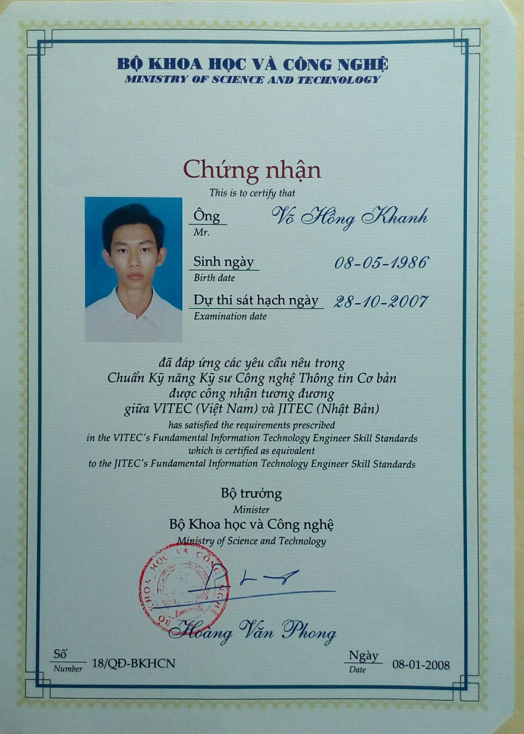
Certificate

Slide 8
GROUPING

Slide 9
Computer Science # Topic 1: Number presentation
Radix convertion
Creates 4-bit binary table
Radix convertion: decimal, octal, hexadecimal, binary
How To Convert Decimal to Binary Using Subtract method: https://www.youtube.com/watch?v=rsxT4FfRBaM
Binary operators
AND, OR, NOT, XOR, LEFT SHIFT, RIGHT SHIFT: https://www.youtube.com/watch?v=xXBitioUzf8
Add, Subtract, Multiply, Divide: https://www.youtube.com/watch?v=mZE_w5L-hyU
Represents integer using 2-complement format: https://www.youtube.com/watch?v=4qH4unVtJkE
Represents real number using Floating point
Decimal to IEEE 754 Floating Point Representation: https://www.youtube.com/watch?v=8afbTaA-gOQ
Represents real number using Biased exponent
IEEE 754 Floating Point Representation to its Decimal Equivalent: https://www.youtube.com/watch?v=LXF-wcoeT0o
Why There is a Bias 127 in Exponent in IEEE 754 Standard Single Precision: https://www.youtube.com/watch?v=aE2kVS0O0OE

Slide 10
Computer Science # Topic 2: Regular Expression
RPN (Reverse Polish Notation)
Tree, Binary Tree & BST (Binary Search Tree)
Tree Traversal: Pre-order traversal, In-order traversal, Post-order traversal (Reverse Polish Notation)
Simplest Binary Tree Traversal trick for preorder inorder postorder
https://www.youtube.com/watch?v=WLvU5EQVZqY
Print Postorder traversal from given Inorder and Preorder traversals:
https://www.geeksforgeeks.org/print-postorder-from-given-inorder-and-preorder-traversals/
How to convert Infix expressions to Reverse Polish Notation expressions: https://www.youtube.com/watch?v=q4pgt6ZOUJc
Calculate value of RPN using Stack: https://www.youtube.com/watch?v=QxHRM0EQHiQ
BNF (Backus-Naur Form)
BNF (BACKUS NAUR FORM): https://www.youtube.com/watch?v=mZE_w5L-hyU
Programming Language Syntax 1 - Backus-Naur Form (BNF): https://www.youtube.com/watch?v=xXBitioUzf8
Hướng dẫn phân tích cú pháp:
https://helpex.vn/article/huong-dan-phan-tich-cu-phap-thuat-toan-va-cong-nghe-phan-5-5c663db6ae03f6012876526b

Slide 11
Computer Science # Topic 3: Data structures (1)
Array: add, remove, find
Linked List: add, remove, find
Stack: push, pop, top, isempty
Queue: enqueue, dequeue
Hash & Collision
Chain method (open hash method): https://www.youtube.com/watch?v=nVu_OnyGk6U
Open address method (closed hash method): https://www.youtube.com/watch?v=yA8bDfWj0UU

Slide 12
Computer Science # Topic 4: Data structures (2)
Tree: All definitions
Binary Tree
BST (Binary Search Tree)
Add node & delete node
Finding value & blancing tree
Heap
Structure of heap
Add node & delete node

Slide 13
Computer Science # Topic 5: Search & Sort
Search: Linear Search & Binary Search
Sort
Selection sort, Bubble sort, Insertion sort: https://visualgo.net/en/sorting
Merge sort: https://www.youtube.com/watch?v=E50u668k_Z8
Shell sort: https://www.youtube.com/watch?v=1yDcmjLTWOg
https://www.youtube.com/watch?v=M3bS6w1R434
Advanced sorting algorithm
Quick sort: https://www.youtube.com/watch?v=qjvx0Ge7aos
Partitioning: https://www.youtube.com/watch?v=MZaf_9IZCrc
Heap sort: https://www.youtube.com/watch?v=-A3AFoS_NDI

Slide 14
Computer Science # Topic 6: String Search
Brute force: https://www.youtube.com/watch?v=vtnpzDPgaU0
Boyer-Moore: https://www.youtube.com/watch?v=ZMQWjslBlbU
KMP (Knuth–Morris–Pratt): https://www.youtube.com/watch?v=klaWddXp0TM
Rabin-Karp: https://www.youtube.com/watch?v=BfUejqd07yo

Slide 15
Computer Science # Topic 7: Graph
Minimum Spanning Tree # Prim: https://www.youtube.com/watch?v=5M7bOXrn54A
Minimum Spanning Tree # Kruskal: https://www.youtube.com/watch?v=ivcbaIhrcsE
Shortest path # Dijkstra: https://www.youtube.com/watch?v=JcN_nq1EAr4
Max flow # Ford-Fulkerson: https://www.youtube.com/watch?v=Tl90tNtKvxs
Graph traversal # BFS: https://www.youtube.com/watch?v=QRq6p9s8NVg
Graph traversal # DFS: https://www.youtube.com/watch?v=iaBEKo5sM7w

Slide 16

FIGHTING!

